Slide 1
Async & Await with Spheros 2
Group 06-06

Slide 2





Meet the team
Hayden Rainey
Lakshmi Kalvakuri
Jyoshna Boppidi
Priyanka Khanal
Mouni Krishna

Slide 3
Async & await
Including async function in the code waits for an operation to be done before moving on.
Async functions may run at the same time as other functions. Ex:(loading files in background)
Including await tells async method will wait until the asynchronous process is complete.
Lakshmi Kalvakuri

Slide 4
JavaScript
JavaScript is a programming language, We can use javascript that renders in all modern web browsers.
For programming in sphero, we use sphero edu app which uses JavaScript code.
JavaScript powers up the draw and blocks programming in the sphero Edu app, It is also possible to view javascript code behind these programs
Lakshmi Kalvakuri

Slide 5
What is Sphero?
Sphero is a spherical robot designed by Sphero.
It was initially prototyped by inventors, Lan Bernstein and Adam Wilson in 2011.
It can be connected and controlled with a smartphone or tablet running Android, IOS or windows phone via Bluetooth.
It is packed with a little Gyroscope, accelerometer and LED lights.
It uses Java Script.
Lakshmi Kalvakuri

Slide 6
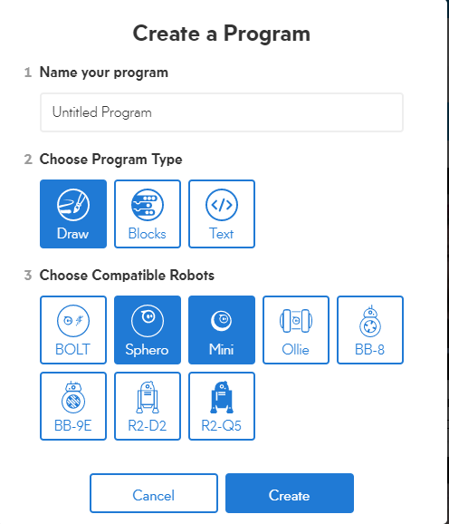
Sphero Draw
In Sphero edu we use draw method for programming .
Using draw we can just easily draw a pattern/path using finger, the sphero can move.
The sphero edu app creates a javaScript code for the robo.
Jyoshna Boppidi

Slide 7
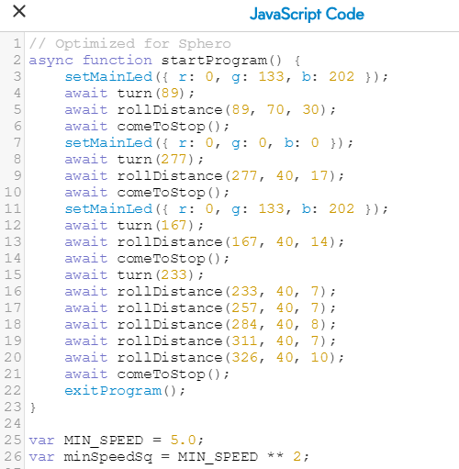
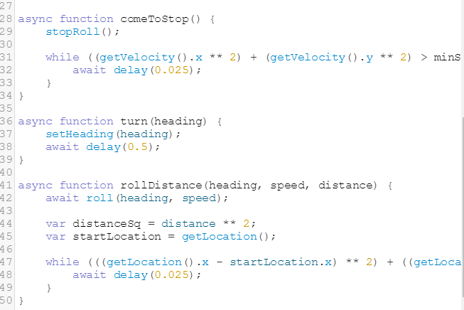
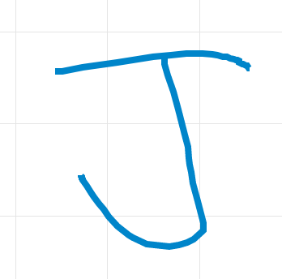
Sphero Draw
Jyoshna Boppidi

Slide 8





Sphero Blocks
Functions used in our sample code:
: changes the color of the main LED light
: will speak a string from your programming device using the text-to-speech engine
: combines heading, speed and duration to make robot roll in one line of code.
: delays execution of the next set of code for a number of seconds.
: executes conditional logic when the robot collides with an object
This is a great place to start for most users with basic knowledge.
The Sphero Blocks allows us to control/add:
Movements, Lights, Sounds, Controls, Operators, Comparators, Sensors, Events, Variables and Functions.
Mouni Krishna Atluri

Slide 9
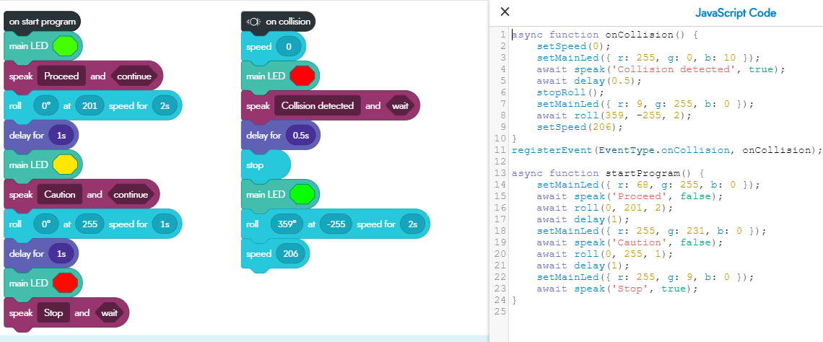
Code using Blocks
Mouni Krishna Atluri

Slide 10
Sphero Text Editor
Uses JavaScript.
IDE makes use of simple commands.
Over simplified error checking.
Does not allow non-asynchronous methods.
Movement methods require await keyword
Block code can be converted into text based code
Example Code
Roll(Degree,Speed,Duration)
Rolls in a specified direction at a specified speed for a specified amount of time
Heading(Degree)
Sets direction robot rolls
SetMainLed({r:255, g:255, b:255})
Sets LED color based on RGB values
Await delay(Seconds)
Delays next command for specified amount of time
Hayden Rainey

Slide 11
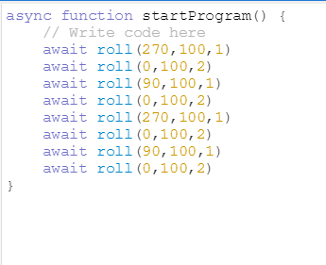
Sphero IDE Example
Requires all functions to be asynchronous
Requires all commands to be prefaced with “await” keyword
This requires each method to complete before the thread moves to the next method
Hayden Rainey

Slide 12

Sphero Play
Can connect to your robot through bluetooth
Can drive robots in several ways like: joystick, tilting, voice, face recognition
Can use the robot as a controller to play games
Priyanka Khanal

Slide 13
Sphero Edu and Sphero Play
Sphero Edu | Sphero Play
Mainly uses CUI | Mainly uses GUI
Variation for coding experience | Variation in AI experience
Can be used in any devices | Requires a handheld device
Priyanka Khanal

Slide 14
Conclusion
We’ve discussed about the async and await functions.
What is a sphero,what are the features it has?
how did we use javascript in the sphero.
Different platforms for coding the sphero
Methods of programming to the sphero (draw,text,blocks)
Events and methods used in handling the sphero
Priyanka Khanal

Slide 15
